Slide 1
Hi Presenter! Read Me Before Using!
This webinar resource is almost ready for you to use! Be sure to:
Look through and add custom information
Slide 2- Title slide (date)
Slide 3- Presenter information
Slide 5- Housekeeping items
Slide 14-15 Demo Site QR Code Screen Shots (optional)
Slide 16 - 17 – District Specific Examples (optional)
Slide 22 – 23 – Edit to reflect audience (optional)
Slide 27 - Resources (optional)
Slide 28 - Thank you slide
There are presenter notes to help guide you- feel free to edit these
This resource can be customized. Here are some examples of how you can personalize this slide deck to suit the needs of your educators and staff:
Replace our images with screen shots from your environment
Read through slides and ensure terms and jargon will resonate with your board policies/ tool names in your Brightspace environment (i.e. Assignments vs Dropbox, Announcements vs News)
Add additional information to slides specific to your district, including how this helps meet district goals, improvements plans, strategic plans etc
Include your district logo on slides or change the colors used to match your district branding

Slide 2
Differentiating Learning in Brightspace
August 2020
© 2020 D2L Corporation
Notes:
<update with date and customer logo with a white or clear background>

Slide 3
Presenter Name Title Company/Organization
@Twitter handle

Slide 4
Agenda
Housekeeping
What is Brightspace?
Create Learning Groups
Using Release Conditions help deliver content to students based on meeting specific criteria
Using Intelligent Agents to automate communication with students

Slide 5
Housekeeping Items
How can people ask questions?
Webinar recording and slide deck will be available on ___________
Information about attendance
Notes:
This slide is for you to add Housekeeping Items particular to your District and this session.
It may include information about how attendees can ask questions, how they can access the webinar information after the session, or even how they confirm their attendance for the session (if applicable)

Slide 6
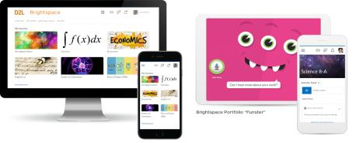
Understanding some terms...
Company:
D2L
Product:
Brightspace
Online Community:
Brightspace Community
Notes:
This is a useful slide to ensure everyone understand the terminology used when discussing Brightspace.
It would be helpful to personalize this slide to include any District specific information, especially if your District as a different branding for “Brightspace.” This will help attendees when they see resources about “Brightspace” to know that this is what your District is using as well but has branded differently.

Slide 7
One platform to collect your teaching resources
Equity for all students
Meaningful connections with students and parents
Why Educators
Brightspace
Tools teachers love
Worry-free technology
Content aligned with curriculum outcomes
Notes:
Here are some reasons Educators love using Brightspace to support their teaching
Tip: Change this up to meet the needs, values and reasons your District loves Brightspace!

Slide 8
Ready to take a look? It’s Demo Time!
Learning Objectives:
Create learning groups of students by shared interest, topic, or ability for assignments
Use Release Conditions help deliver content to students based on meeting specific criteria

Slide 9
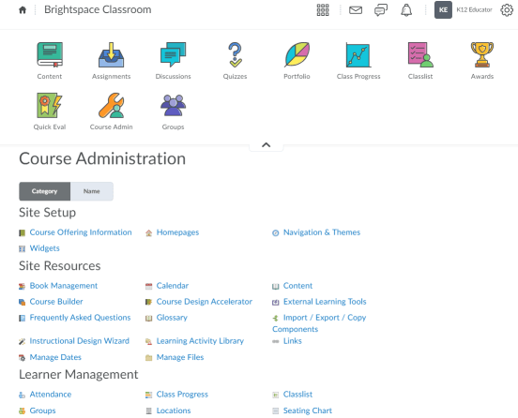
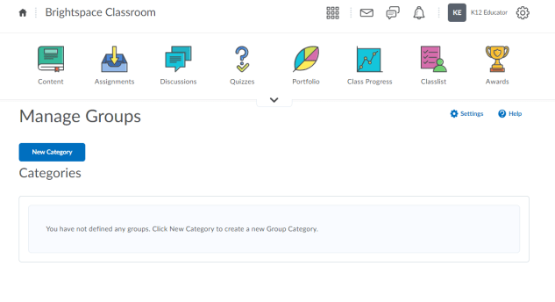
How to Create a Group (1/2)
1
2
Navigate to the Groups tool from either your Navbar or Course Admin
Create “New Category”

Slide 10
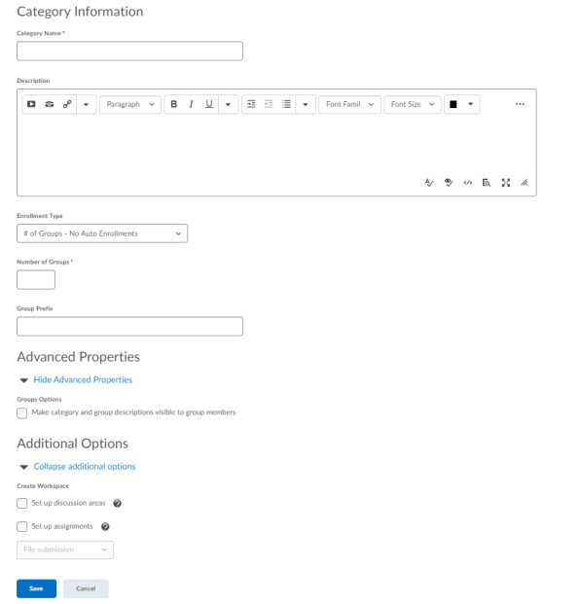
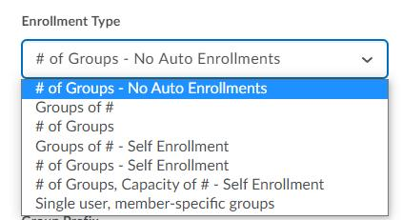
How to Create a Group (2/2)
1
Give your Group Category a name and description
Choose how you want students to be enrolled into you’re the Groups and how many Groups you want created. You may also provide a Group Prefix, if applicable
Optional: Check this box to make the Group description visible to students
Optional: Set up a Discussion area or an Assignment for these Groups
Save
2
3
4
5

Slide 11
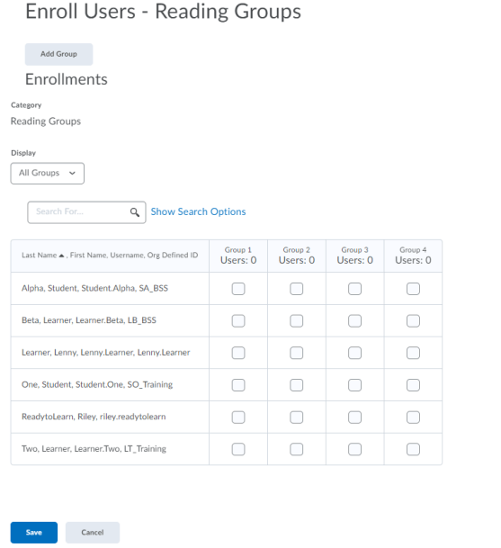
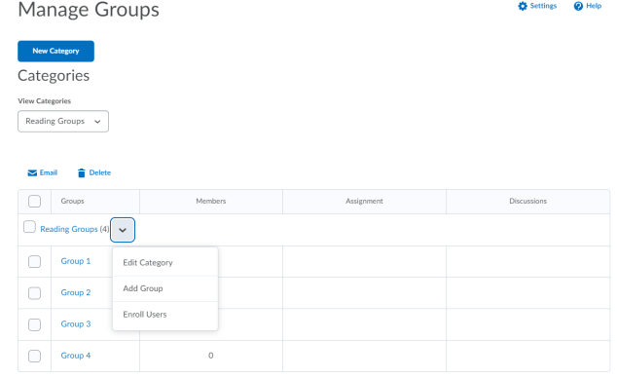
Manually Enroll Students into a Group
2
1
Select the menu options for your Group Category and select “Enroll Users”
Select which Group you would like students to be enrolled in. (You may also manually change enrollments this way as well)
Save
3

Slide 12
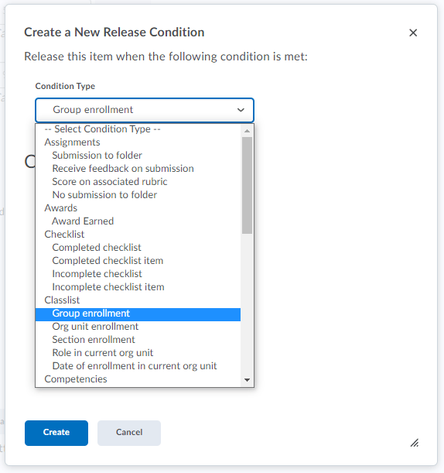
Using Groups as a Release Condition (1/2)
1
Click “Create and Attach”
Under Condition Type, choose “Group Enrollment,” which can be found under Classlist
2

Slide 13
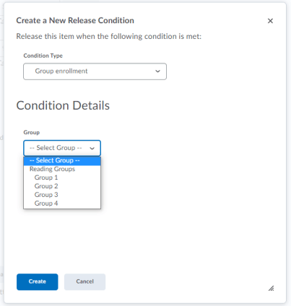
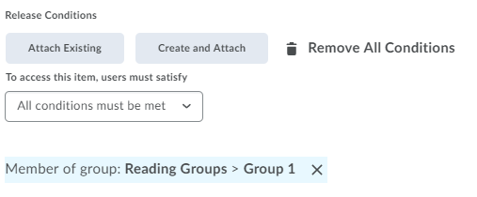
Using Groups as a Release Condition (2/2)
5
3
4
Choose which Group you would like to release this item to
Click “Create”
Now you can see there is one Release Condition where the condition of this item being seen is based on being in Reading Groups-Group 1

Slide 14
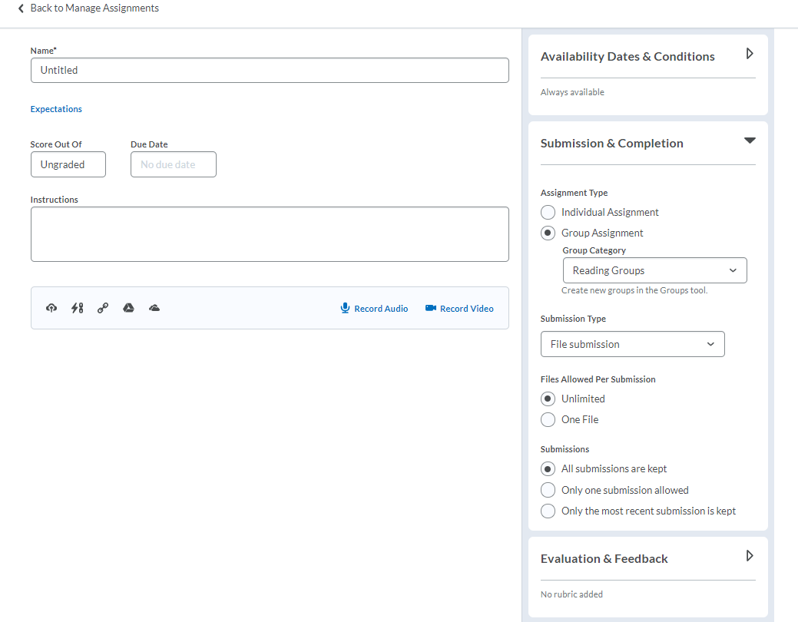
Creating a Group Assignment
Select “Group Assignment” under Assignment Type
Select which Group Category you want this group assignment to apply to
1
2

Slide 15
What are Release Conditions?
Release conditions allow educators to create a custom learning path through the materials in their course. When you attach a release condition to an item, students cannot see that item until they meet the associated condition.
For example, you could attach a release condition to the second topic in your course’s content area that would hide that topic until the student viewed the topic before it. Or you could create a condition that requires students to view a content topic before gaining access to a quiz, or one that required them to post to a discussion topic before they could see a content module.
What Tools Support Release Conditions?
You can access release conditions for any of the following course items:
Awards
Checklist
Content
Custom widgets
Discussions
Assignments
Intelligent Agents
Announcements
Quizzes
Surveys
Learn more about the Types of Release Conditions available for you to use, here.
Curious about Best Practices for using Release Conditions? Check out some ideas here.

Slide 16
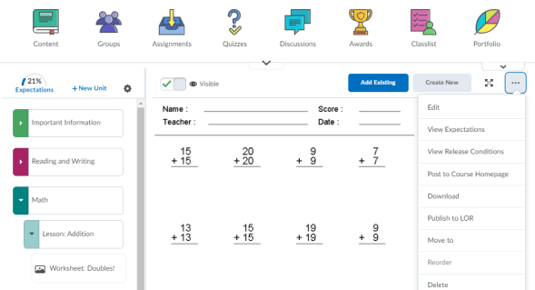
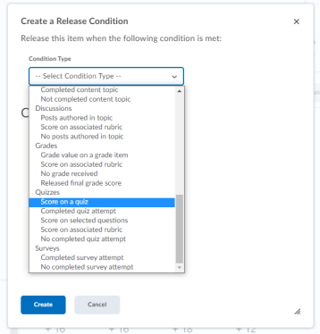
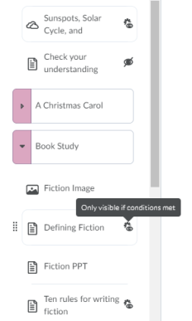
Creating Release Conditions for Content
: Confirms a Release Condition has been assigned to the Content item
Once in Content, you need to select the Content item that you want to attach a release condition first.
Time-Saver Tip:
Use Browse to apply previously created Release Conditions

Slide 17
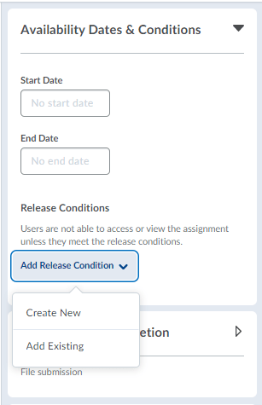
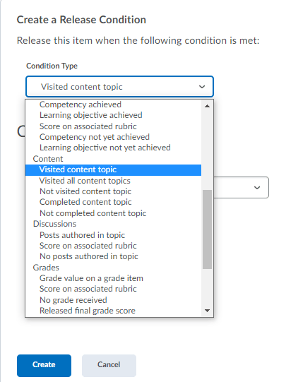
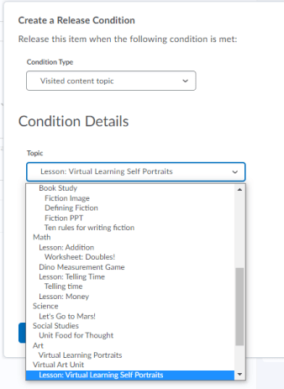
Creating Release Conditions for an Assignment
Time-Saver Tip: Use Add Existing to apply previously created Release Conditions

Slide 18
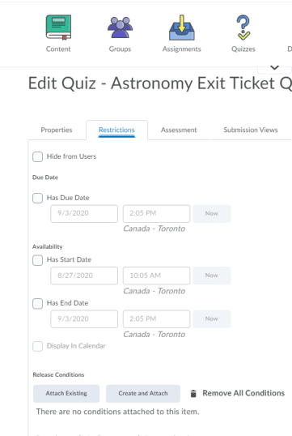
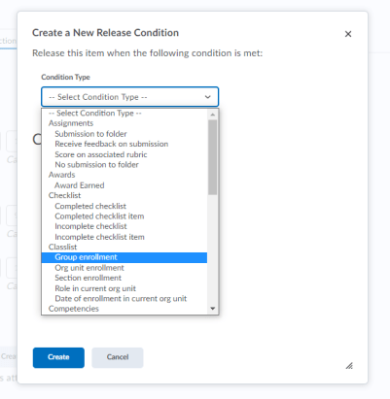
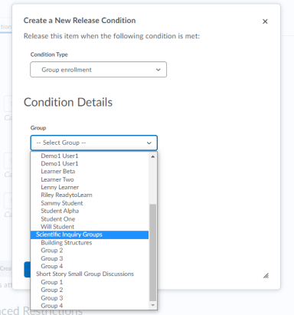
Creating Release Conditions in Quizzes
Time-Saver Tip: Use Add Existing to apply previously created Release Conditions

Slide 19
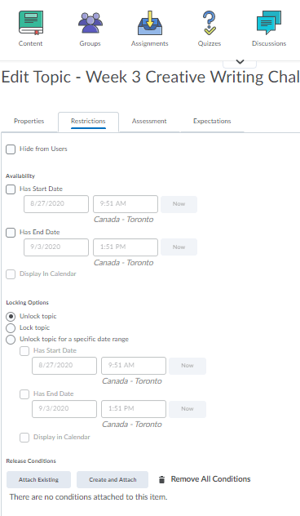
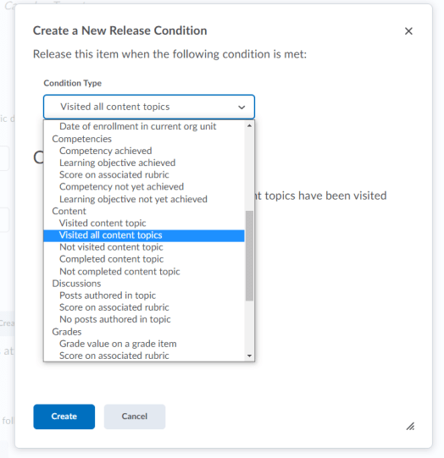
Creating Release Conditions for Discussions
Time-Saver Tip: Use Add Existing to apply previously created Release Conditions

Slide 20
The Awards tool is a fun and engaging way to share positive encouragement, promote healthy competition, or even gamify the learning experience.
Turn your course into a “choose your own adventure” journey, a competitive escape room, or a whodunit mystery by using badges and certificates within the Awards tool to release clues that rely upon student performance and participation to crack the proverbial code.
What is the Award tool?

Slide 21
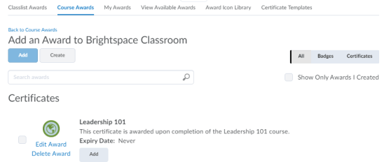
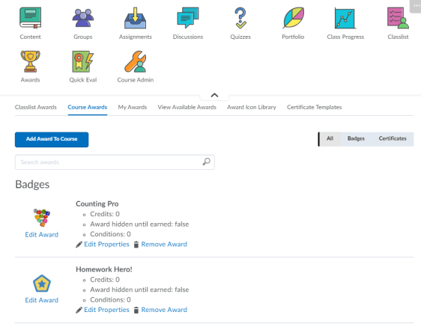
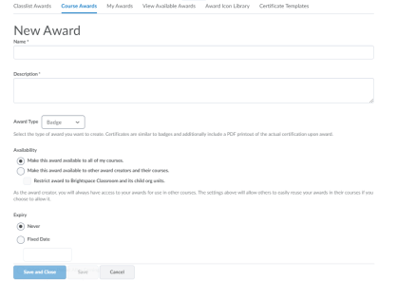
How to Create a New Award
4.
1.
2.
3.
5.
Click Awards
Click Course Awards
Click Add Award to Course
Click Create
Fill in the fields to create your own award
Note: The same workflow applies to the creation of badges and certificates

Slide 22
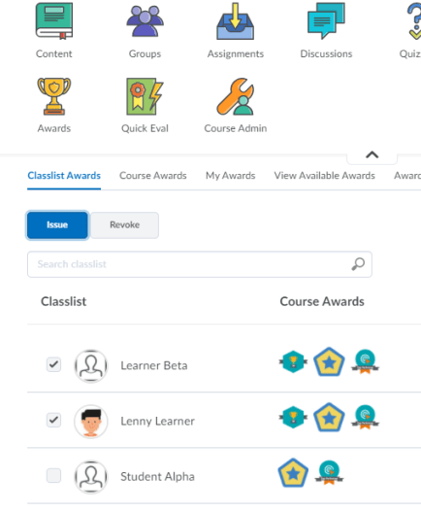
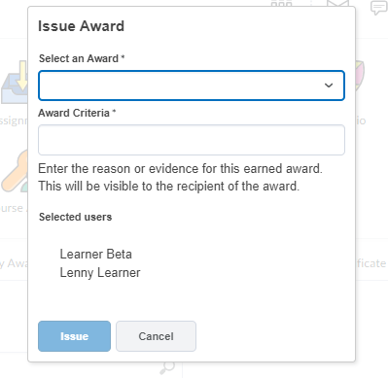
How to Issue an Award
4.
1.
3.
Click Awards
Select the students to receive the award
Click Issue
Select the badge/certificate you want to issue and add the criteria for the recipient
Note: To revoke an award, follow the same workflow
2.

Slide 23
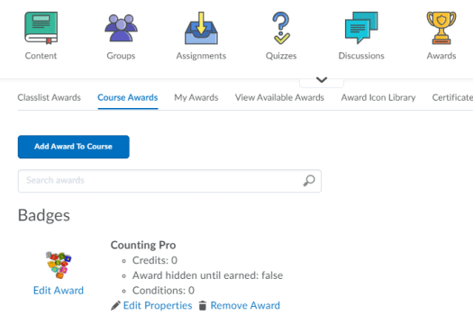
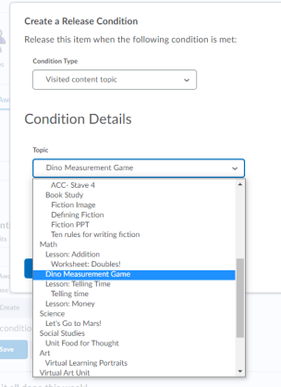
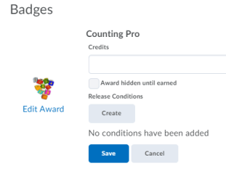
Using Release Conditions with Awards

Slide 24
Intelligent Agents monitor course activity based on the criteria you set. Based on the selected criteria (course activity and/ or release condition), you can send emails to your students to promote improved engagement.​
​
Intelligent Agents incorporate the same release conditions criteria found throughout Brightspace. They also have two unique sets of conditions not found in release conditions. ​
Login Activity: The agent will activate if users haven’t logged into the system for a prescribed period of time. NOTE: Agents can also be used to positively reinforce when students have logged in consistently.​
Course Activity: The agent will activate if users haven’t accessed a course for a prescribed period of time.
What is an
Intelligent
Agent?

Slide 25
Intelligent Agents are extremely useful and can save educators time while also preventing students from slipping through the cracks, as they allow you to prepare automated emails that will be sent only if certain conditions are or are not met.
A few typical use cases include:
Reaching out with a check-in message to any students who haven’t logged in to the course in X number of days
Providing additional support and resources to any students who received a score below X on an assessment
Sending a reminder to any students who have NOT completed something
Acknowledgement that something has been completed
Why Educators Use Intelligent Agents?

Slide 26
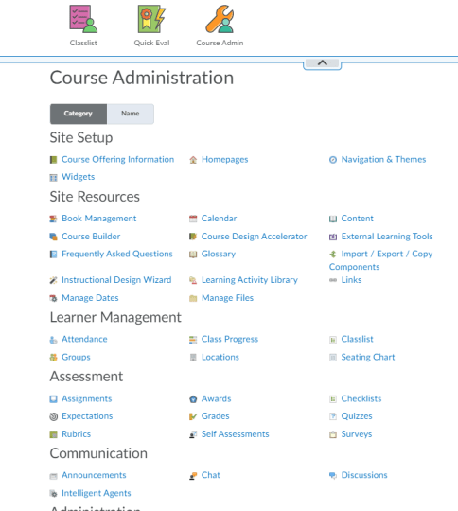
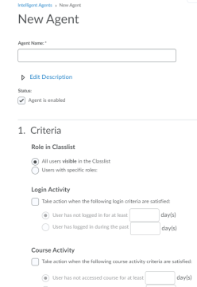
How do I create an Intelligent Agent?
1.
3.
4.
1. Click Course Admin from your NavBar
2. Click on Intelligent Agents
3. Click on New
4. Fill in the fields to create a new Intelligent Agent
Make sure your Agent is set to “Enabled”
2.

Slide 27
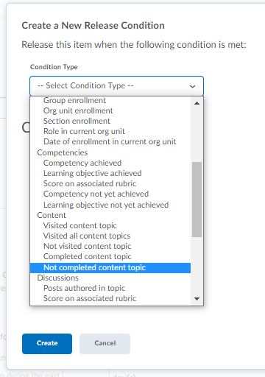
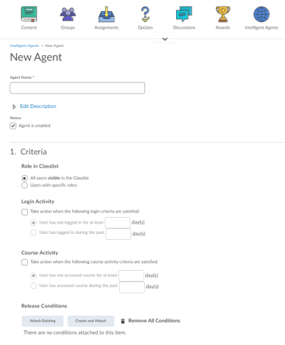
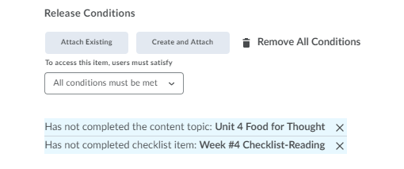
Using Release Conditions with Intelligent Agents
More than one Release Conditions can be used if you want to add more conditions to any item!

Slide 28
Resources: Differentiated Learning in Brightspace
Brightspace can help you accommodate and differentiate your teaching
How to Personalize Learning in a Digital Classroom
Create a Custom Learning Path in a Course
Attach a Release Condition: Content
Customize Content Paths Using Release Conditions

Slide 29
Resources
D2L Parent and Guardian Support Site
Brightspace Tutorials
D2L Education Webinars
Check out: An Introduction to Accessibility in Brightspace
Recording Coming Soon: Building Online Learning Groups
D2l One-Minute Workflow Videos
D2L- Teaching from Home Resources
D2L Quick Start Guide for K12 Educators

Slide 30
Tutorial Videos
Communication and Collaboration | Organizing Course Materials | Documenting Student Learning | Feedback & Assessment
Announcements Activity Feed -Add Attachments and Links to Posts -Create an Assignment Post in Activity Feed -Customize Notifications for Activity Feed -For posting a message -Optimize Activity Feed Discussions | Content/Lessons Tool -Getting Started with Lessons for Instructors -Lessons: Add a New Unit and Lesson -Lessons: Add New Materials -Lessons: Reorder Units, Lessons, Folders, and Materials -Lessons: Attach a Release Condition Groups -Creating Groups -Creating Individual Student Groups -Creating Unique Learner Pathways | Brightspace Portfolio -Review and Approve Portfolio Items -Oversee and View Individual Portfolios -Brightspace Portfolio: Bring Your Own Device (for learners) -Portfolio AT HOME Assignments Discussions Quizzes -Quiz Question Converter | Rubrics -Create an Analytic Rubric -Create a Holistic Rubric Grades -Entering Grades -Associate an Activity with a Grade Item -Create a Grade Scheme Standards/Expectations -Standards: Import Standards from Course Admin Assessing or Evaluating Against Expectations Quick Eval
Notes:
There are also many quick tutorial videos available! These resources are organized pedagogically. Every underlined item is linked to a tutorial video

Slide 31
Thank you!
@Twitterhandle
#districthashtag
#D2LK12
Notes:
Thank you so much for joining us today!
If you have any questions or need any help, please consult or contact:
We’d love to see all the awesome ways you’re using Brightspace! Use our District hashtag and/or #D2LK12 so we can all learn from each other and share great ideas of how to use Brightspace to support teaching, learning and, most importantly, our students!

